Slide 1

Analysis and Derivation of Optimum Domain Specific Semantic Model for Detecting Depression Text From Twitter Stream
SRM Institute of Science and Technology, Ramapuram Campus
DEPARTMENT OF COMPUTER SCIENCE AND ENGINEERING
Batch No:G-16
Presented By Aman Ehtesam RA1711003020418 Bhaskar Bhakat RA1711003020439 Piyush Kumar RA1711003020445 B.TECH-IV YEAR Computer Science & Engineering SRM Institute of Science & Technology Ramapuram Campus, Chennai-89 | Guided By Ms. Ashwini C. Assistant Professor Computer Science & Engineering SRM Institute of Science & Technology Ramapuram Campus, Chennai-89

Slide 2
OBJECTIVE
The objective of this project is to apply Natural Language Processing and Machine Learning techniques to build a system in which a given set of tweets taken from a user using twitter API for prediction of depression tweets.
Detect Real time emotion and sentiment of users from Twitter
Emotion and Sentimental Analysis of real-time twitter data for a particular domain like cryptocurrency, bitcoin, lockdown.

Slide 3
SCOPE
Depression diagnosis can be used in medical profession
Can be integrated to any social media platform to analyze real time users mental health.

Slide 4
ABSTRACT
Depression is a serious challenge in personal and public health. Every year one in 15 adults are affected by depression. According to WHO, more than 300 million people globally suffer from depression. An individual with depression is 20 times more likely to die from suicide than someone without depression.
Depression specially, prevalent in young individuals from 15 to 29 years old and this age group also has suicide as second leading cause of death. We consider English content gathered from web-based media.

Slide 5
Web media like twitter are brimming with feelings, sentiments, and assessments of individuals everywhere in the world. Nonetheless, examining and characterizing text based on feelings is a major test and can be considered a high-level Sentiment Analysis.
Our approach is based on machine learning classification algorithms and Natural Language Processing which uses textual features like degree of words and negations, Parts of Speech, grammatical analysis and emoticons.
However, on a huge dataset, emotional words are mapped with emotional intensities. At last, through our project, we can successfully identify particular text behaviour and successfully predict on the depression tendency.

Slide 6
INTRODUCTION
Depression is the leading cause of disability, often undiagnosed, and one of the most treatable mood disorders. It is the leading cause of disability worldwide with more than 300 million people suffering from depression.
Depression is costly to society as well as to those personally impacted by depression. Depression is predicted to cost an estimated 5.36 trillion US dollars worldwide between 2011 and by 2030.
This proposition aims to apply natural language processing on Twitter feeds for conducting emotion analysis focusing on depression.

Slide 7
Individual tweets are classified as positive or negative, based on a curated word-list to detect depression tendencies.
Numerous machine learning algorithms are available for the classification of the tweets, some of them are Naïve Bayes, Support vector machine algorithms, Random forest algorithms etc.
The performance of the algorithms can be measured over different metrics like accuracy, precision, recall and confusion matrix.

Slide 8
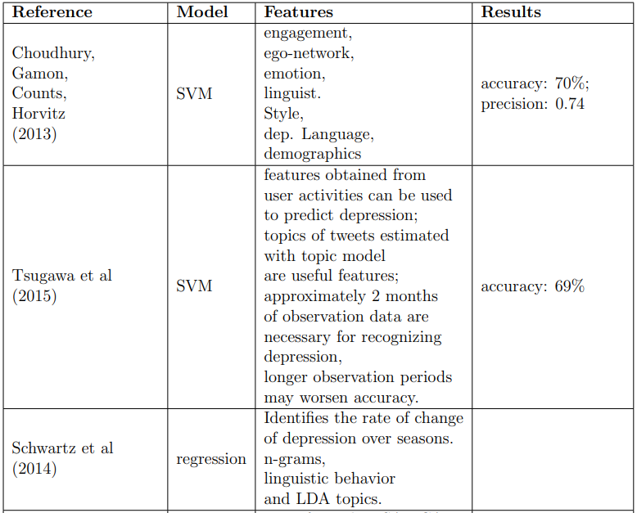
LITERATURE SURVEY

Slide 9
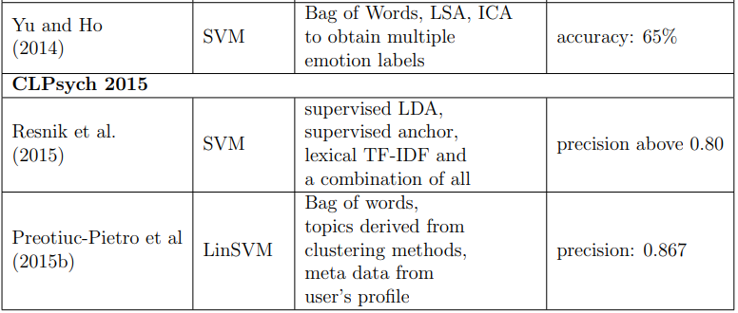

Slide 10
EXISTING SYSTEM
In existing system, they have compare the private and public available data of a users to screen for depression.
Existing system uses text messages and tweets from the past two weeks to a year to predict scores on the Patient Health
The existing approach involves comprehensive feature engineering, feature selection, and machine learning. Word category frequencies, part of speech tag frequencies, emotion, and loudness are among the current 245 characteristics.
The best model is Logistic Regression built on the top ten features from two weeks of text data. This model achieves an average F1 score of 0:806, AUC of 83%, and recall of 0:925.

Slide 11
DRAWBACK OF EXISTING SYSTEM
There’s no option to fetch real time twitter data of a particular user.
Its difficult to collect private data from the users
Solutions have been proved ineffective
Extremely difficult for the classification algorithm to predict
Training is performed using only the minority class

Slide 12
PROPOSED SYSTEM
Proposed system use Natural Language Processing and Machine Learning techniques to build a system in which a given set of tweets taken from a users using twitter API for prediction of depression tweets.
We propose an automated system that can identify users emotion and sentiments from their public social media activity.
More specifically, we identify users with Twitter account using Twitter API. To achieve this goal we trained a user-level classifier using Support Vector Machine (SVM) that can detect at-risk users with a recall of 0.89 and a precision of 0.88.
The best model is SVM and this model achieves an accuracy of 93%.

Slide 13
Advantages of Proposed System
Improved traceability
Predicts real time users tweet
Increased efficiency and speed
Enhanced security
Greater transparency
Alteration of data is incredibly difficult

Slide 14
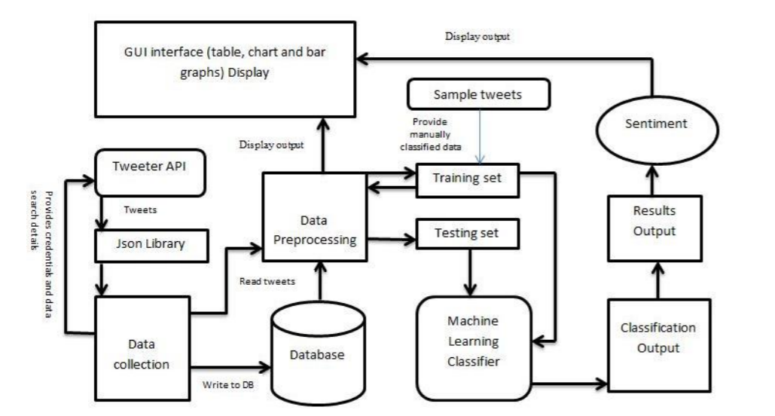
ARCHITECTURE
Architecture Diagram

Slide 15
MODULES
Module 1 : Data Exploration
Tweets are written mostly in informal way. We use Tweepy to gather tweets, which is a Python library for getting to the Twitter API.
It takes as information various limits, similar to headings, range, etc, and after the removal of duplicates, joins, hashtags, and words in other than English from these tweets, stores the tweet-ids, text, and stack the most recent ones in the informational collection.
Eg: The Tweets Set, we made for Delhi has around 16,000 sections. Another way we utilized Tweepy is by taking care of it a twitter-username (of a client) as a contribution to store every one of the tweets of that client (till date), in our data set.

Slide 16
Module 2 : Preprocessing
Used NLP for preprocessing
•Select English tweets.
•Transform the text into lowercase.
•Delete URL present in a twitter text.
•Erasure of notification, retweet sees, and pointless numbers.
•hastags can be taken out for better outcome.
•Changing the emoticons with their importance.
For instance (":D")stands for laugh/happiness with respect to table I. •Striping highlights ['"?!,.():;] from the tokenized words.
•words should not be removed from to create confusion.
•Stemming and lemmatizing the tokenized words.
•Making syntactic highlights tags for those tokenized words in the end.

Slide 17
Module 3 : Feature Selection
In Sentiment Analysis , feature extraction can be defined as a process of extracting a set of new features from the features set that is generated in feature selection stage.
Feature Ex: Word category frequencies, part of speech tag frequencies, emotion, and loudness etc.
Term frequency (TF) is how often a word appears in a document, divided by how many words there are.
TF(t) = (Number of times term t appears in a document) / (Total number of terms in the document)
The inverse document frequency(IDF) is a measure of whether a term is common or rare in a given document corpus.

Slide 18
Module 4: Classification Techniques
We have utilized Support Vector Machine in our model.
We by then inquiry Tweepy using these seed words to develop an enormous data base of around 16,000 tweets.
The seed words are used to ensure that we get tweets that express at any rate one of the five sentiments.
The retweets are removed out to keep from any emphasis of tweets. The even allocation of seed words ensures that we get even dispersal of tweets over all of the EmotionCategories, so our classifier isn't uneven.
Regardless, we have analyzed that there is an enormous degree of tweets on Twitter imparting bliss, so we have kept the quantity of seed words having the Emotion-Category HAPPINESS, on the higher side.

Slide 19
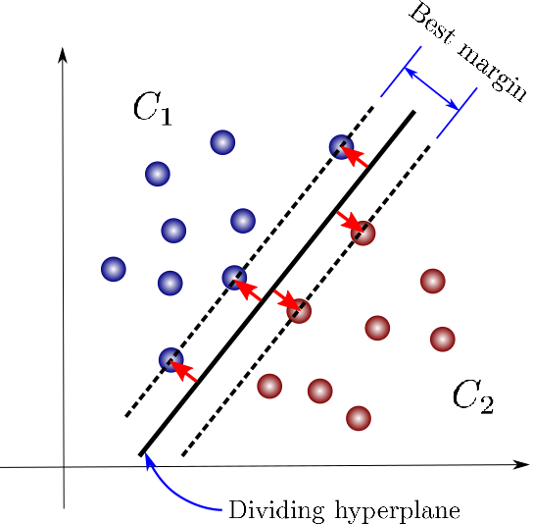
SUPPORT VECTOR MACHINE

Slide 20
Advantages of Proposed Algorithm
Computational Complexity is significantly reduced
Lowering the Complexity Threshold
Simplify Training Process

Slide 21
ALGORITHM USED
Used NLP for text pre-processing
For Feature Selection we have used Term frequency (TF) – Inverse Document Frequency
Used Support Vector Machine for Model Prediction

Slide 22
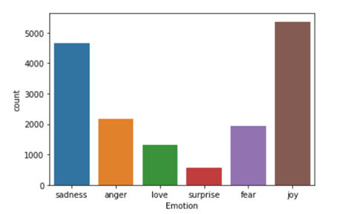
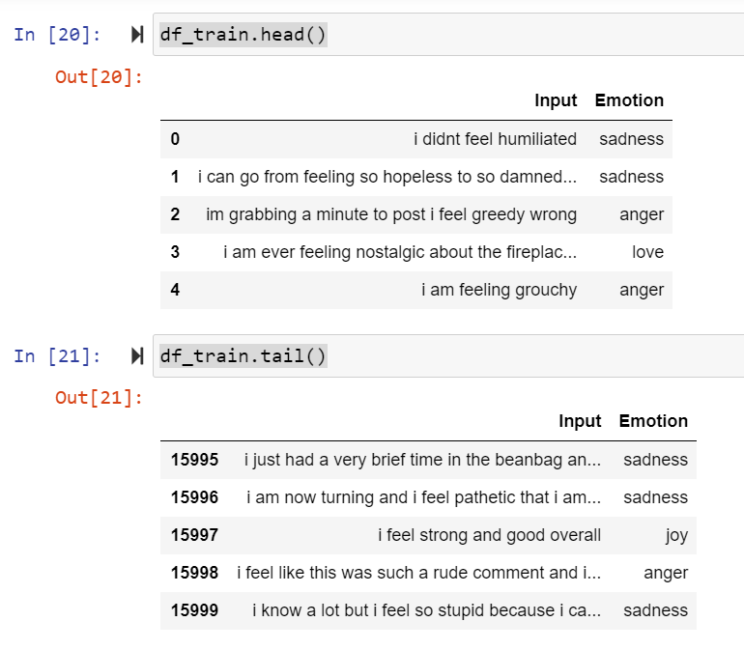
IMPLEMENTATION

Slide 23
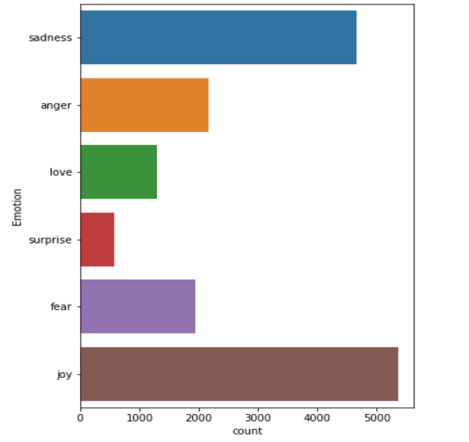
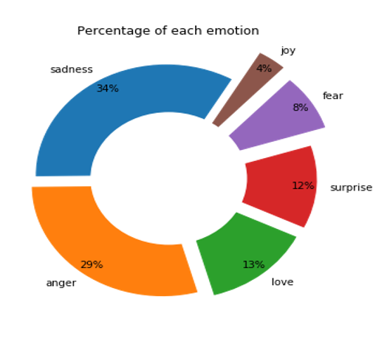

Slide 24
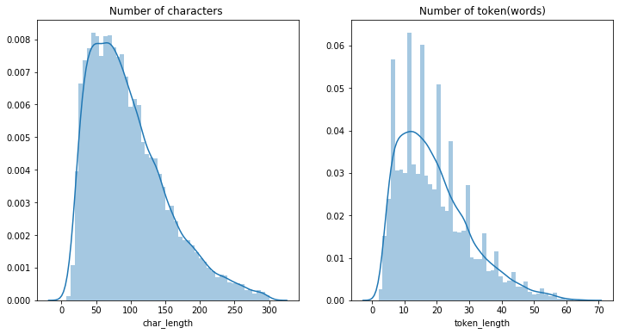
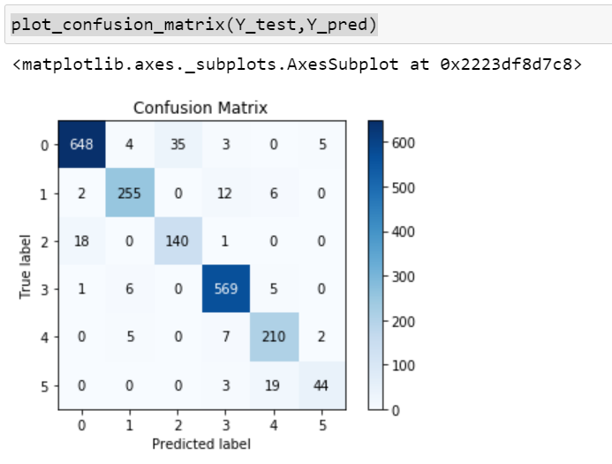

Slide 25
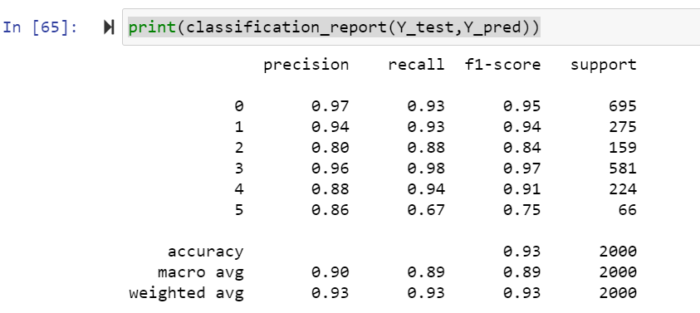
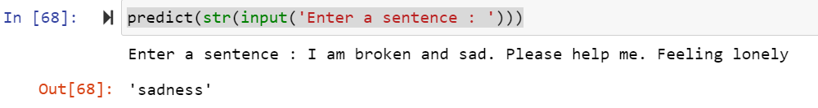

Slide 26
CONCLUSION
In this system, an existing twitter dataset was used in which we apply SVM, Naïve Bayes Classifier.
The goal is to measure accuracy for multiple ML algorithms, and then develop a model that use to take input as a user sentiment to predict depression.
We can conclude that for the context of depression detection SVM has performed well and gives highest accuracy of 94%.

Slide 27
FUTURE WORK
Future research will focus on scalability and speeding up the total response time to further improve the user experience.
From an implementation point of view, we recommend using the training data to find the best parameters to optimize the SVM models for detecting users at-risk of depression
In future, a feature can be added which will notify users about mental health directly to their twitter account.

Slide 28
REFERENCES
[1] Guozheng Rao, Yue Zhang, Li Zhang, Qing Cong and Zhiyong Feng, “MGL-CNN: A Hierarchical Posts Representations Model for Identifying Depressed Individuals in Online Forums”, IEEE Access(Volume: 8),February 2020, DOI: 10.1109/ACCESS.2020.2973737.
[2] Mark E. Larsen, Tjeerd W. Boonstra; Philip J. Batterham; Bridianne O’Dea, Cecile Paris, and Helen Christensen, “We Feel: Mapping Emotion on Twitter,” in IEEE Journal of Biomedical and Health Informatics, 2015, DOI 10.1109/JBHI.2015.2403839.
[3] Marcel Trotzek, Sven Koitka, and Christoph M. Friedrich, “Utilizing Neural Networks and Linguistic Metadata for Early Detection of Depression Indications in Text Sequences,” in IEEE Transactions on Knowledge and Data Engineering (Vol: 32), 2018,DOI: 10.1109/TKDE.2018.2885515.
[4] Budhaditya Saha, Thin Nguyen, Dinh Phung, and Svetha Venkatesh, “A Framework for Classifying Online Mental Health-Related Communities With an Interest in Depression,” in IEEE Journal of Biomedical and Health Informatics, 2016, vol. 20, DOI: 10.1109/JBHI.2016.2543741.
[5] Michael M. Tadesse, Hongfei Lin, and Liang Yang, “Detection of Depression-Related Posts in Reddit Social Media Forum”,in IEEE Access, 2019, DOI: 10.1109/ACCESS.2019.2909180.

Slide 29
[6] ML Tlachac and Elke Rundensteiner, “Screening For Depression With Retrospectively Harvested Private Versus Public Text,” in IEEE Journal of Biomedical and Health Informatics, 2020, DOI: 10.1109/JBHI.2020.2983035.
[7] Les Servi and Sara Beth Elson, “A Mathematical Approach to Gauging Influence by Identifying Shifts in the Emotions of Social Media Users” in IEEE Transactions on Computational Social Systems DOI 10.1109/TCSS.2014.2384216.
[8] Firoj Fattulal Shahare, “Feeling discovery through online media” in Proceedings of the 2017 conference on (ICICCS),DOI 10.1109/ICCONS.2017.8250692.
[9] Altug Akay, Andrei Dragomir,and Björn -Erik Erlandsson, “Assessing Antidepressants Using Intelligent Data Monitoring and Mining of Online Fora”, IEEE Journal of Biomedical and Health Informatics ( Volume: 20), 2016, DOI: 10.1109/JBHI.2016.2539972.
[10] Norah Saleh Alghamdi, Hanan A. Hosni Mahmoud, Ajith Abraham, Samar Awadh Alanazi, and Laura García-Hernán, “Predicting Depression Symptoms in an Arabic Psychological Forum”,IEEE Access(Volume:8), 2020, DOI: 10.1109/ACCESS.2020.2981834
[11] kay, Andrei Dragomir,and Björn -Erik Erlandsson, “Assessing Antidepressants Using Intelligent Data Monitoring and Mining of Online Fora”, IEEE Journal of Biomedical and Health Informatics ( Volume: 20), 2016, DOI: 10.1109/JBHI.2016.2539972

Slide 30
THANK YOU

